Slide 1

Advanced Machine Learning
mini-PROJECT
Notes:
In our project, we investigated the task of Fake News detection using NLP approaches.

Slide 2
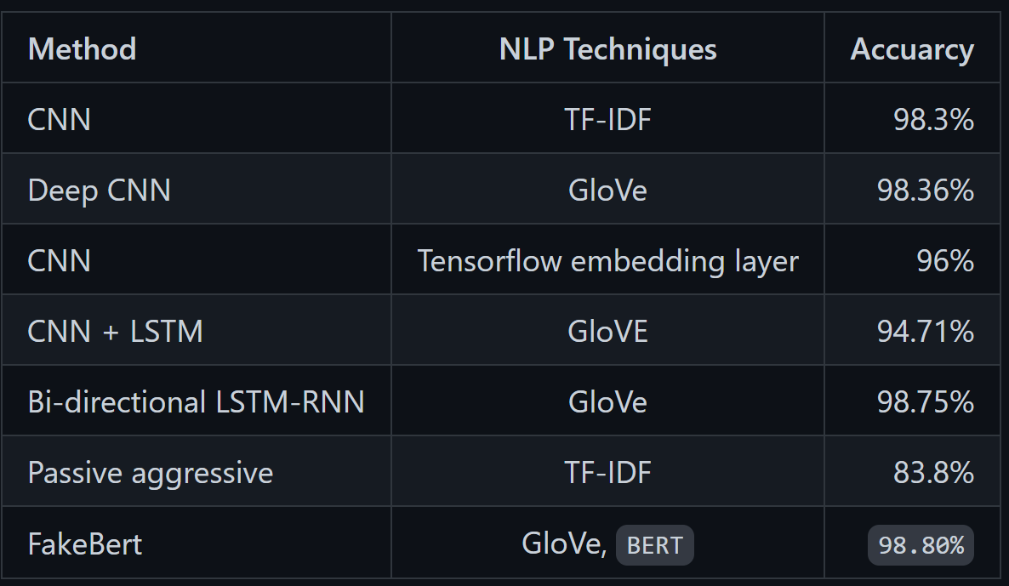
Approaches to Fake News Detection
A simple binary classification? Think again!
Literature: A Comprehensive Review on Fake News Detection With Deep Learning.
Notes:
From the literature review, we confirmed that advanced sequential models outperform simple machine learning approaches. We therefore choose to use a transformer model, more concretely a BERT (Bidirectional Encoder Representations from Transformers)

Slide 3
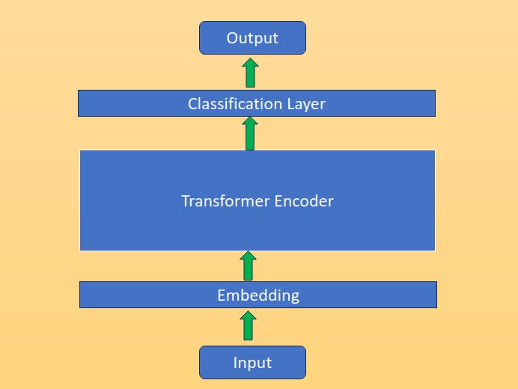

Transformers model pretrained on a large corpus of English data and fine-tuned on Fake News dataset.
Model:
BERT
Simple linear layer returning class probabilities
Notes:
To adapt the architecture, we append a linear layer to the output so it returns the class probability and labels the instance to the higher one.

Slide 4

Results
Performance matrices on our test predictions:
Accuracy: 0.987
Precision: 0.995
Recall: 0.977
F1 Score: 0.986
FPR: 0.004
TPR: 0.977
Notes:
Our predication on the test data showed obvious high performance same as the ones shown in the literature and also in the kaggle competition in the all performance metrices, with accuracy of 0.987, precision of 0.995, recall of 0.977 and F1 score of 0.986.

Slide 5
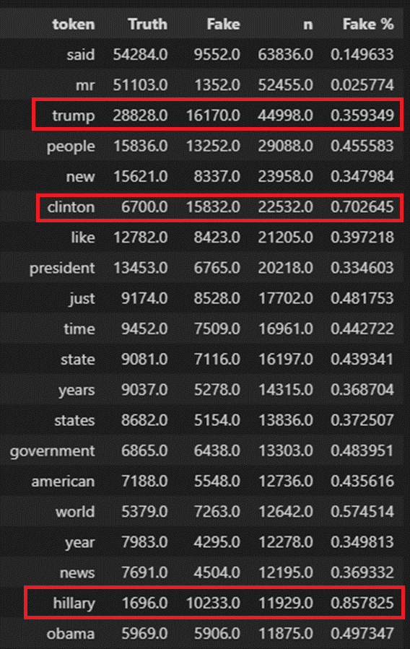
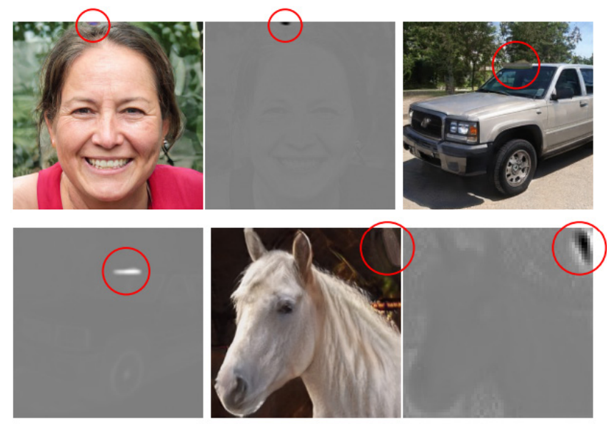
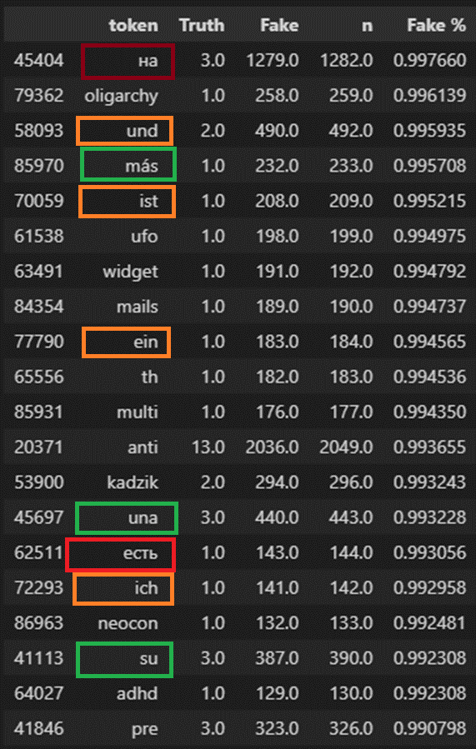
Experiments
Experiment 1:
Replacing highly polarized political names for common names.
Is the model learning shortcuts to classification from token presence?
Result: 5 instances changed label (0.27%)
Experiment 2:
Inserting foreign language tokens associated with Fake News.
Result: 9 instances changed label (0.43%)
Notes:
From the EDA we suspected the model might be overfitting the predictions to the presence of some specific tokens in the text.

Slide 6
Conclusion
Fake news detection is a critical yet challenging problem in Natural Language Processing (NLP) (Oshikawa et al.)
Although advanced sequential models achieve high performance in discriminating fake news, this results might be misleading.
A broader aspect of fake news can include several other tasks:
Fact-Checking
Rumor Detection
Stance Detection
Sentiment Analysis
Although classification is the main approach, regression is also possible.
Simple changes or insertions in the text did not substantially modify the predictions, although it did change the model certainty.
Adversarial agents could easily engineer texts to avoid automatic detection.
In many cases, the task would require fact checking or additional context unavailable to the model.

